Slide 1
HackSLU 2026
2HAC Presents:
CanvasCurator
By: 2 Henries (one Morgan + one Beblo), THE Addison Thurston, and A Carter DeLargy

Slide 2
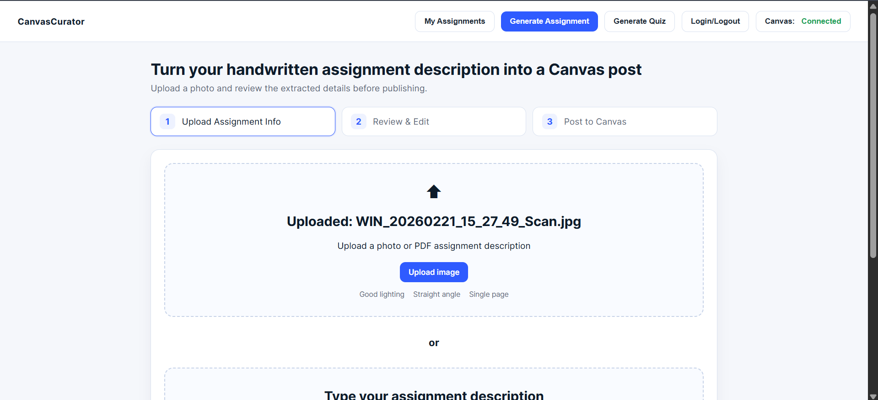
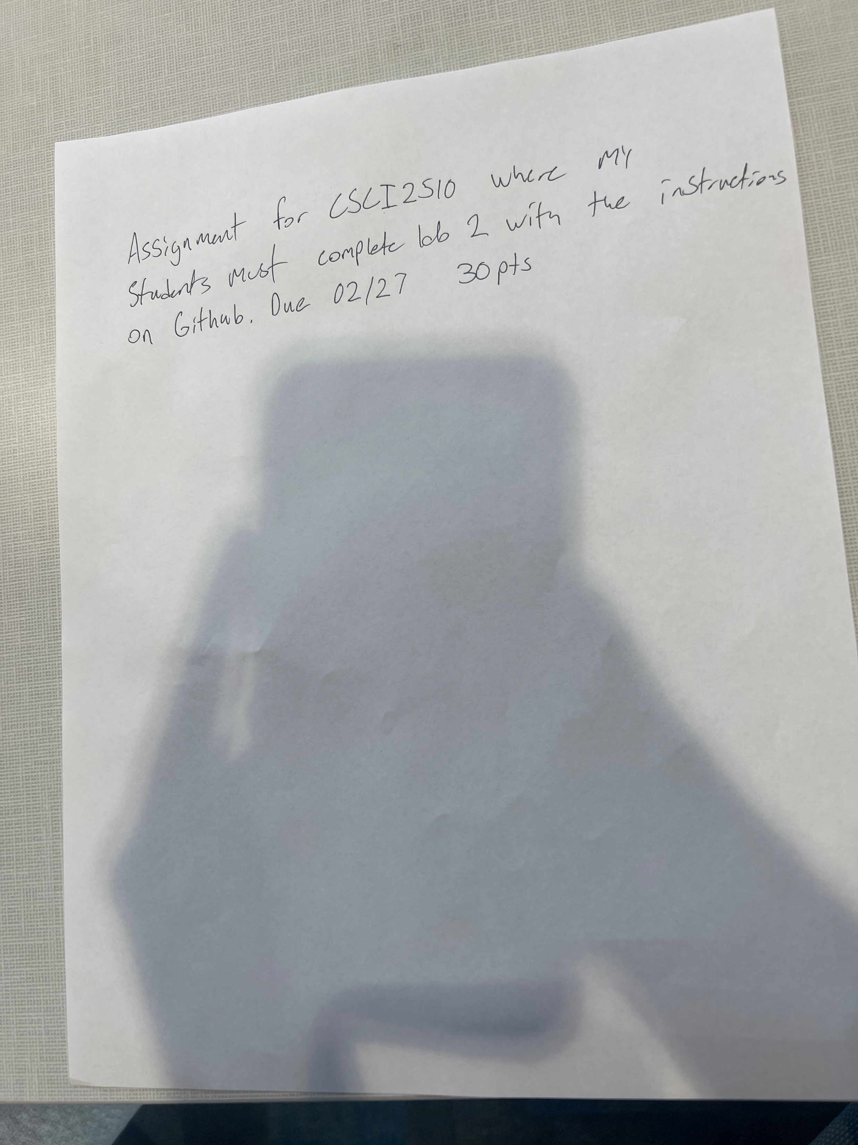
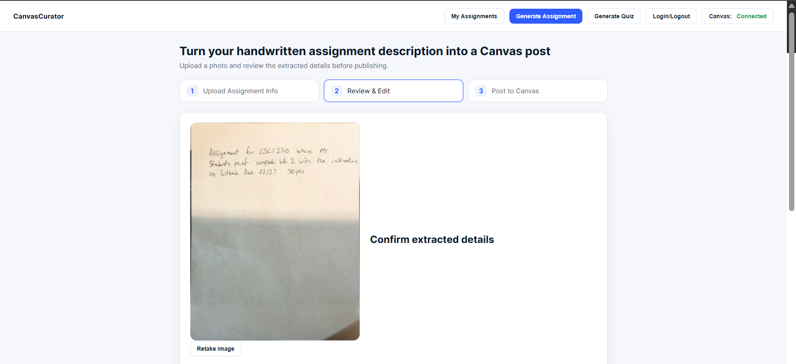
CanvasCurator In Action

Slide 3
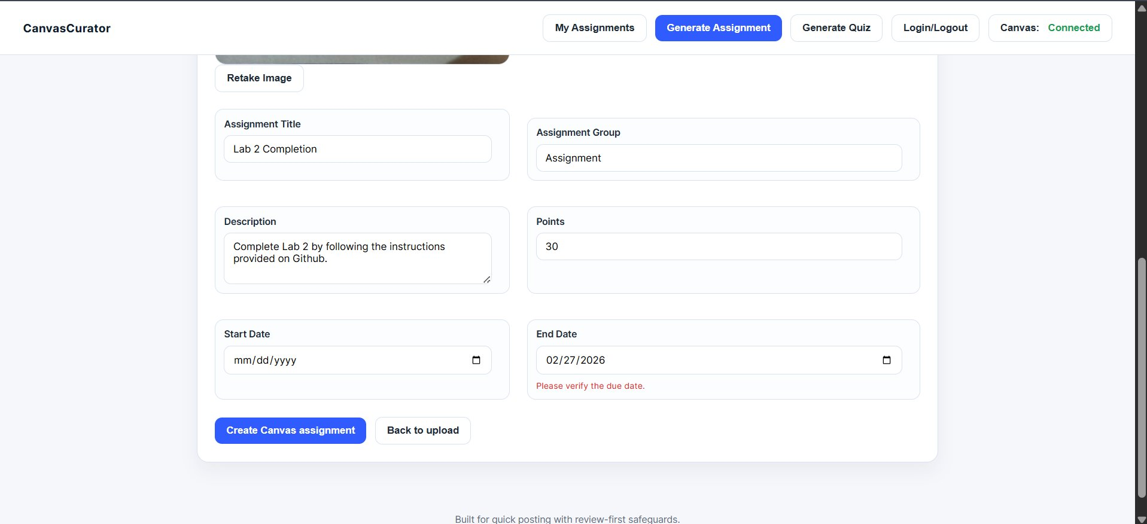
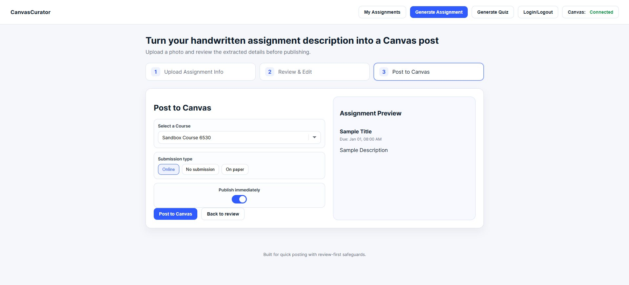

Slide 4
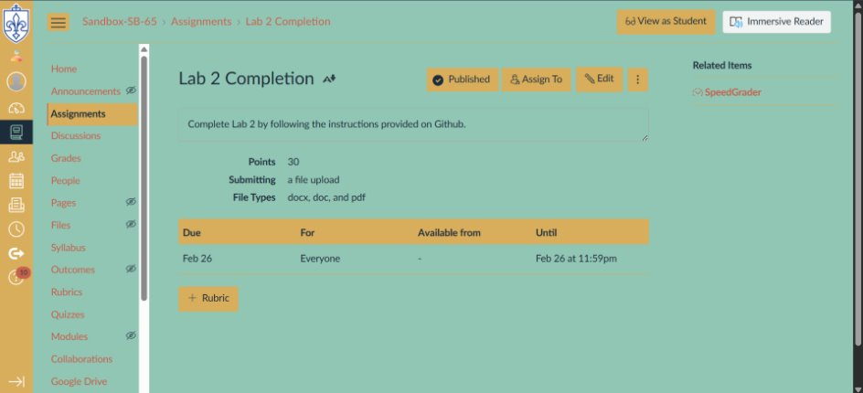

Slide 5
Geometric Fitter
Photos of notes are cropped and transformed to display notes as a neat rectangle.
  Transformation achieved via CV2.
Photo is prepared for reading by AI.

Slide 6
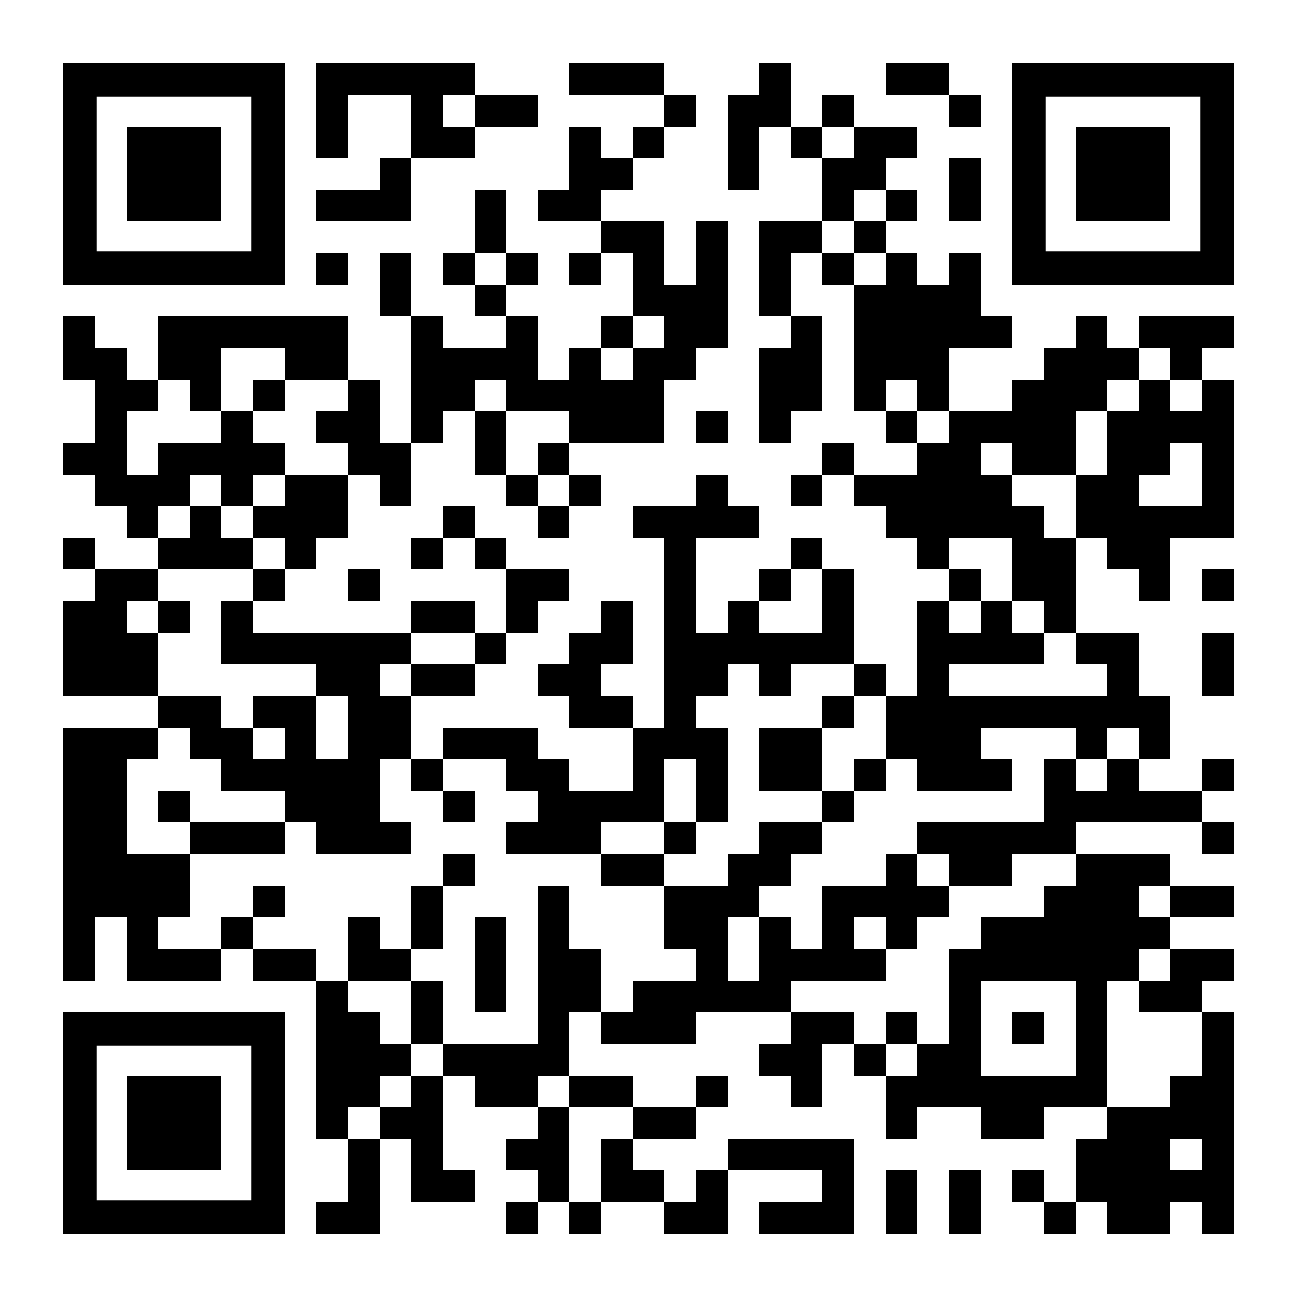
Handwriting:
Digitalization & Interpretation
Test Cases and Results:

Slide 7
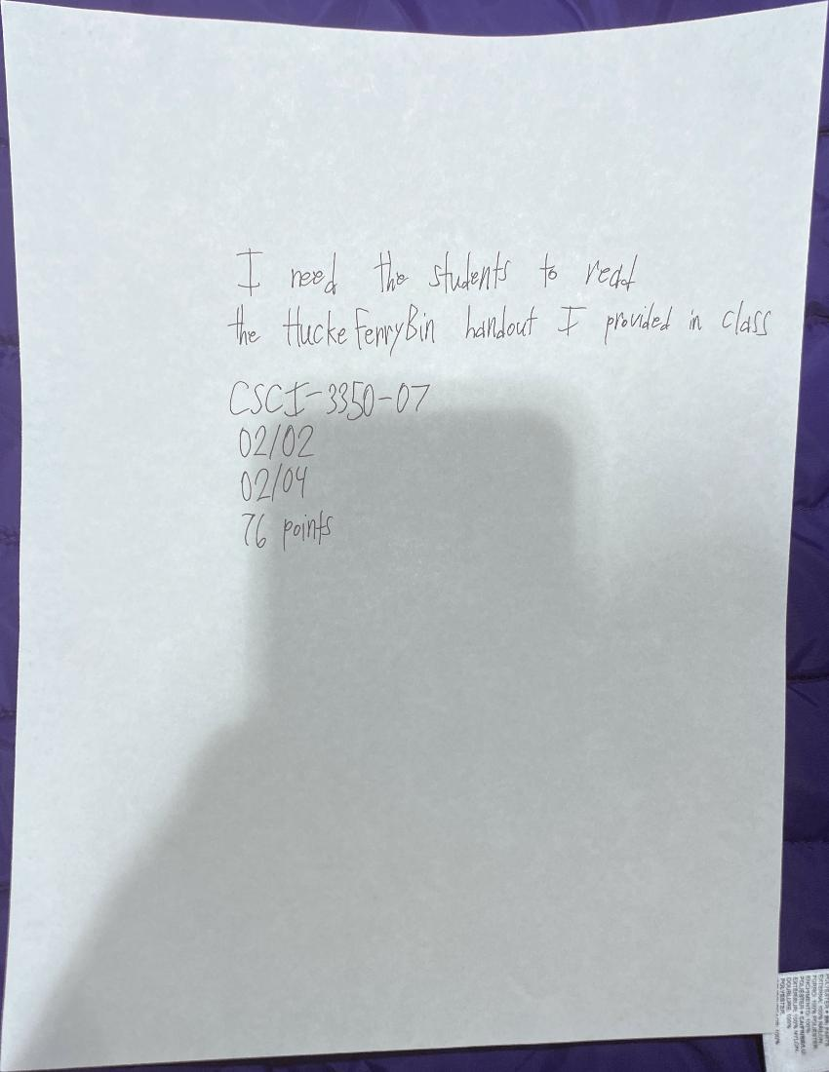
Simplified Steps
  Handwriting scanned and digitalized via the Google Cloud Vision API
    No text being detected is accounted for
  Text processed and formatted via Gemini Pro 2.5 API
    Output divided by |
Output from Gemini:
CSCI-3350-07|Hacke Ferry Bin Handout Reading|Reading|Please read the Hacke Ferry Bin handout provided in class.|76|02/20|02/04

Slide 8
Website Development
Assignment or quiz?
Upload file or brief description
Review contents
  Revise contents
Press post!

Slide 9
Optimizing Canvas for Professors and Students
Hello! I, Professor Zilch, would like to request an assignment to be posted for my Geology class, course GEO-1100-09. The assignment must cover the key identifiers of the various rocks and minerals found near volcanos, an assignment of which students shall observe and reflect upon such facets of said rocks and minerals. Let my task be due tomorrow, expected of all geology students. Of course, it is pass/fail, as were all my assignments prior.
For Students
Information accessibility
Improved assignment receival
For Professors
Streamlined Canvas experience
Enhanced assignment and quiz posting and creation

